Slide 1
Object Oriented Programming in JAVA
(Practical#13)

Slide 2
Objective: To become familiar with Multi-Threading.
Definition: Multithreading refers to two or more tasks executing concurrently within a single program.
A multithreaded program contains two or more parts that can run concurrently
What is Concurrency ?
Definitions: Simultaneous Execution of multiple operations/ tasks.
OR Multiple Operations /tasks are Executing in parallel.
Example : Compile a program , send a file to a printer and receive a e-mail message over a network concurrently.

Slide 3
Multithreading
Definition: Multithreading refers to two or more tasks executing concurrently within a single program.
Multithreading is a specialized form of multitasking.
A multithreaded program contains two or more parts that can run concurrently. Each part of such a program is called a thread and each part can handle a different task at the same time, making optimal use of the available resources specially when your computer has multiple CPUs.

Slide 4
// program without multithreading
public class fordemo {
public static void main(String[] args) {
// prints odd number up to 10
for(int i=1; i<=10; i+=2)
System.out.println(i);
// prints odd numberes up to 10
for(int j=1; j<=10; j+=2)
System.out.println(j); } } // end class forDemo

Slide 5
// one program 2 tasks with multithreading run in parallel
public class fordemo {
public static void main(String[] args) {
// *** Task 1 print odd number up tp 10 ***//
for(int i=1; i<=10; i+=2)
System.out.println(i); // task 1 ends
// *** Task 2 print odd Numbers up to 10 ***//
for(int j=1; j<=10; j+=2)
System.out.println(j); // task 2 ends } }

Slide 6
What is a Thread ?
Definition: Thread is basically a lightweight sub-process, a smallest unit of processing.
A thread is an independent path of execution within a program.
A multithreaded program contains two or more parts that can run concurrently.
Each part of such a program is called a thread, and
many threads can run concurrently within a program.

Slide 7
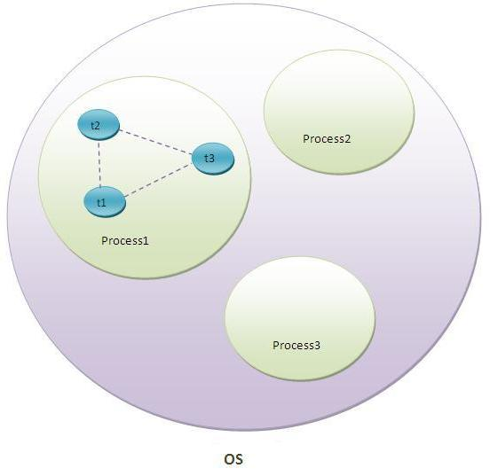
Multithreading
What is Thread in java
A thread is a lightweight sub process, a smallest
unit of processing.
It is a separate path of execution.
Threads are independent, if there occurs exception
in one thread,
it doesn't affect other threads. It shares a common memory area.

Slide 8
Multithreading
Multithreading has several advantages over Multiprocessing such as;
Threads are lightweight compared to processes
Threads allow different tasks to be performed concurrently.
Threads share the same address space and therefore can share both data and code
Context switching between threads is usually less expensive than between processes
Cost of thread intercommunication is relatively low than that of process intercommunication

Slide 9
Java is a multi-threaded programming language which means we can develop multi-threaded program using Java.
Java provides built-in support for multithreaded programming.
Java makes concurrency available to the programmer through its APIs.
Every thread in Java is created and controlled by the java.lang.Thread class.
The programmer specifies that application contains threads of execution, where each tread designates a portion of a program that may execute concurrently with other threads. This capability is called Multithreading.

Slide 10
Multithreading
How to create thread There are two ways to create a thread:
1)By extending Thread class
2)By implementing Runnable interface.
Thread class: Thread class provide constructors and methods to create and perform operations on a thread. Thread class extends Object class and implements Runnable interface.

Slide 11
Multithreading
Commonly used Constructors of Thread class:
Thread()
Thread(String name)
Thread(Runnable r)
Thread(Runnable r, String name)
Note : If you are extending the Thread class, your class object would be treated as a thread object. So you don't need to explicitly create Thread class object. your class run() method may execute.

Slide 12
Commonly used methods of Thread class:
public void start(): starts the execution of the thread.
JVM calls the run() method on the thread.
public void run(): is used to perform action for a thread.
public void sleep(long milliseconds): Causes the currently executing thread to sleep (temporarily cease execution) for the specified number of milliseconds.
public void join(): waits for a thread to die.
public String setName( String Name): sets the name of the thread.
public String getName(): returns the name of the thread.
public Thread currentThread(): returns the reference of currently executing thread.

Slide 13
public int getPriority(): returns the priority of the thread.
public int setPriority(int priority): changes the priority of the thread.
public int getId(): returns the id of the thread.
public boolean isDaemon(): tests if the thread is a daemon thread.
public void setDaemon(boolean b): marks the thread as daemon or user
thread. A parameter of true denotes this Thread as a daemon thread.

Slide 14
public void stop(): is used to stop the thread(depricated).
public void interrupt(): interrupts the thread.
public boolean isInterrupted(): tests if the thread has been interrupted.
public static boolean interrupted(): tests if the current thread has been interrupted.

Slide 15
public Thread.getState(): returns the state of the thread.
public boolean isAlive(): tests if the thread is alive.
public void yield(): causes the currently executing thread object to temporarily pause and allow other threads to execute.
public void suspend(): is used to suspend the thread(depricated).
public void resume(): is used to resume the suspended thread(depricated).

Slide 16
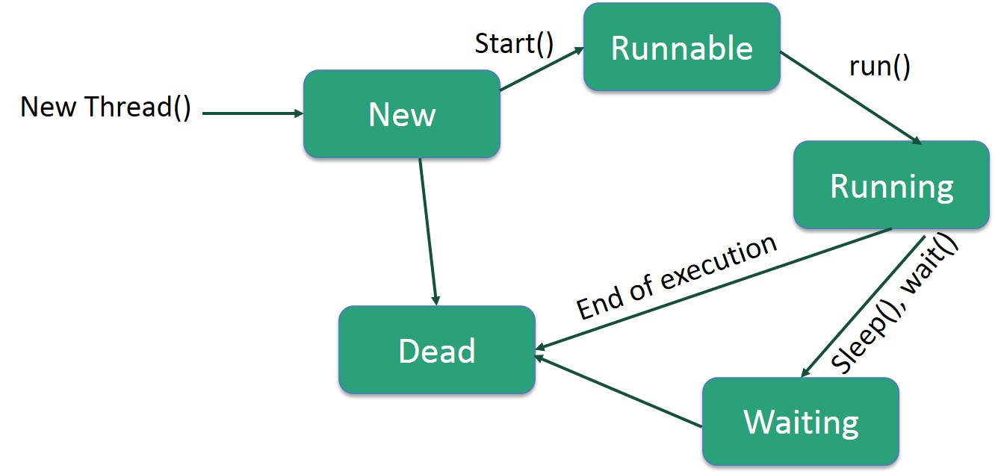
Thread States ?
Any time a thread is said to be in one of several thread states.
1) New
The thread is in new state if you create an instance
of Thread class but before the invocation of
start() method.
2) Runnable
The thread is in runnable state after invocation of start()
method, but the thread scheduler has not selected it to
be the running thread. (ready)
3) Running
The thread is in running state if the thread scheduler
has selected it.
4) Non-Runnable (Blocked)
This is the state when the thread is still alive, but is
currently not eligible to run.
5) Terminated A thread is in terminated or dead state when its
run() method exits.

Slide 17
start () and run() method
public void start(): starts the execution of the thread.
JVM calls the run() method on the thread.
method run is the code to be executed by new thread.
public void run(): is used to perform action for a thread.

Slide 18
Sleep method in java
The sleep() method of Thread class is used to sleep a thread for the specified amount of time.
Syntax of sleep() method in java
The Thread class provides two methods for sleeping a thread:
public static void sleep(long miliseconds)throws InterruptedException
public static void sleep(long miliseconds, int nanos)throws InterruptedException

Slide 19
join method
The join() method waits for a thread to die. In other words, it causes the currently running threads to stop executing until the thread it joins with completes its task.
Syntax:
public void join()throws InterruptedException
public void join(long milliseconds)throws InterruptedException

Slide 20
Naming Thread
The Thread class provides methods to change and get the name of a thread.
By default, each thread has a name i.e. thread-0, thread-1 and so on.
We can change the name of a thread by using setName() method.
The syntax of setName() and getName() methods are given below:
public String getName(): is used to return the name of a thread.
public void setName(String name): is used to change the name of a thread.
The currentThread() method returns a reference of currently executing thread.

Slide 21
Priority of a Thread (Thread Priority):
Each thread have a priority. Priorities are represented by a number between 1 and 10.
In most cases, thread scheduler schedules the threads according to their priority (known as preemptive scheduling).
But it is not guaranteed because it depends on JVM specification that which scheduling it chooses.
3 constants defiend in Thread class:
public static int MIN_PRIORITY
public static int NORM_PRIORITY
public static int MAX_PRIORITY
Default priority of a thread is 5 (NORM_PRIORITY). The value of MIN_PRIORITY is 1 and the value of MAX_PRIORITY is 10.

Slide 22
Runnable interface:
The Runnable interface should be implemented by any class whose instances are intended to be executed by a thread.
Runnable interface have only one method named run().
public void run(): is used to perform action for a thread.
Starting a thread:
start() method of Thread class is used to start a newly created thread. It performs following tasks: A new thread starts(with new callstack).
The thread moves from New state to the Runnable state.
When the thread gets a chance to execute, its target run() method will run.

Slide 23
Daemon Thread in Java
Just a quick note on main thread: When the JVM starts, it creates a thread called “Main”. Your program will run on this thread, unless you create additional threads yourself. The first thing the “Main” thread does is to look for your static void main (String args[]) method and invoke it. That is the entry-point to your program. If you create additional threads in the main method those threads would be the child threads of main thread.
Daemon thread in java is a service provider thread that provides services to the user thread. Its life depend on the mercy of user threads i.e. when all the user threads dies, JVM terminates this thread automatically.

Slide 24
Daemon Thread in Java
There are many java daemon threads running automatically e.g. gc, finalizer etc.
You can see all the detail by typing the jconsole in the command prompt. The jconsole tool provides information about the loaded classes, memory usage, running threads etc.
Points to remember for Daemon Thread in Java
It provides services to user threads for background supporting tasks. It has no role in life than to serve user threads.
Its life depends on user threads.
It is a low priority thread.

Slide 25
Uses of Daemon Threads
Daemon threads are useful for background supporting tasks such as garbage collection, releasing memory of unused objects and removing unwanted entries from the cache. Most of the JVM threads are daemon threads.

Slide 26
Methods for Java Daemon thread by Thread class
The java.lang.Thread class provides two methods for java daemon thread.
No. | Method | Description
1) | public void setDaemon(boolean status) | is used to mark the current thread as daemon thread or user thread.
2) | public boolean isDaemon() | is used to check that current is daemon.

Slide 27
Synchronization in Java
Synchronization in java is the capability to control the access of multiple threads to any shared resource.
Java Synchronization is better option where we want to allow only one thread to access the shared resource.
Why use Synchronization
The synchronization is mainly used to
To prevent thread interference.
To prevent consistency problem.
Types of Synchronization
There are two types of synchronization
Process Synchronization
Thread Synchronization

Slide 28
When we start two or more threads within a program, there may be a situation when multiple threads try to access the same resource and finally they can produce unforeseen result due to concurrency issues. For example, if multiple threads try to write within a same file then they may corrupt the data because one of the threads can override data or while one thread is opening the same file at the same time another thread might be closing the same file.
So there is a need to synchronize the action of multiple threads and make sure that only one thread can access the resource at a given point in time. This is implemented using a concept called monitors. Each object in Java is associated with a monitor, which a thread can lock or unlock. Only one thread at a time may hold a lock on a monitor.
Java programming language provides a very handy way of creating threads and synchronizing their task by using synchronized blocks. You keep shared resources within this block. Following is the general form of the synchronized statement −

Slide 29
Multi-thread applications are useful to execute more than one operations simultaneously. However, if more than one threads are accessing a shared resource, there is a high risk of data corruption or unexpected result. This article explains the reason for the unexpected results and the possible solution to avoid it.
Thread synchronization is the concurrent execution of two or more threads that share critical resources. Threads should be synchronized to avoid critical resource use conflicts. Otherwise, conflicts may arise when parallel-running threads attempt to modify a common variable at the same time.

Slide 30
Thread scheduler in java is the part of the JVM that decides which thread should run.
There is no guarantee that which runnable thread will be chosen to run by the thread scheduler.

Slide 31
Task # 1:
Write a program based on threads. Perform multi-threading and print even and such that when the numbers reach at value 30 then give a delay of 5 seconds. After the delay, the program will continue to print the series at the same manner

